Slide 1

Tourism Reservation database system
name: Okiror simon peter
Reg no. 2025/BCS/160/PS
Course: Database Systems
Lecturer: Kenneth Baguma
Date : May/05^{th/}2026
Notes:
Good morning/afternoon, my name is ________. Today I am presenting my project titled Tourism Reservation Database System. This project focuses on using a database system to manage tourism booking operations such as tours, hotels, transport, and payments.

Slide 2
Introduction
This project focuses on designing a Tourism Reservation Database System
The system manages
Customer bookings
Tour selection
Hotel reservations
Transport arrangements
Payments
Developed using MySQL in XAMPP environment
Notes:
This system is designed to manage tourism services in a centralized way. It integrates customer bookings, tour selection, hotel reservations, transport arrangements, and payment processing into one system. For example, a customer planning to visit Queen Elizabeth National Park can complete the entire booking process within this system.

Slide 3
System Overview
Tourism reservation system
Centralized database
Manages bookings and services
Notes:
This system is a Tourism Reservation Database System designed to manage all tourism-related services in one place. It provides a centralized database that stores customer information, bookings, hotel reservations, transport details, and payments. The goal is to improve efficiency and ensure all data is well organized and easily accessible.

Slide 4
Problem statement
Manual tourism booking is slow and error-prone
Data duplication and loss can occur
Difficult to manage multiple bookings efficiently
No centralized system for managing tourism operations
Notes:
In many tourism organizations, booking processes are still handled manually. This leads to issues such as data loss, duplication, and inefficiency. For example, using paper records or spreadsheets makes it difficult to manage and track bookings accurately.

Slide 5
objectives
Design a relational database for tourism management
Store customer and booking information efficiently
Link tours, hotels, transport, and payments
Ensure data integrity using relationships and keys
Notes:
The main objective of this project is to design a structured database system that improves how tourism data is managed. It focuses on storing customer and booking information efficiently and linking all related services together. For example, one booking connects a customer to a tour, hotel, payment, and transport.

Slide 6
Database Requirements
Store customer data
Manage bookings
Track payments
Link all services
Notes:
The system was designed based on key requirements. It must be able to store customer information, manage bookings, track payments, and link all services together. These requirements ensure that the system supports the needs of both customers and administrators

Slide 7
Database entities
The system contains 6 main entities:
Customer
Tour
Hotel
Booking
Payment
Transport
Notes:
The system is composed of several entities that represent different parts of the tourism process. These include Customer, Tour, Hotel, Booking, Payment, and Transport. Each entity stores specific information, and together they form the complete system.

Slide 8
relationships
Customer → Booking (1:M)
Tour → Booking (1:M)
Hotel → Booking (1:M)
Booking → Payment (1:M)
Booking → Transport (1:M)
booking is the central table connecting all entities
Notes:
These entities are connected through relationships that define how data is linked. For instance, one customer can make multiple bookings, and each booking is linked to a specific tour and hotel. Additionally, each booking can have associated payment and transport records.

Slide 9
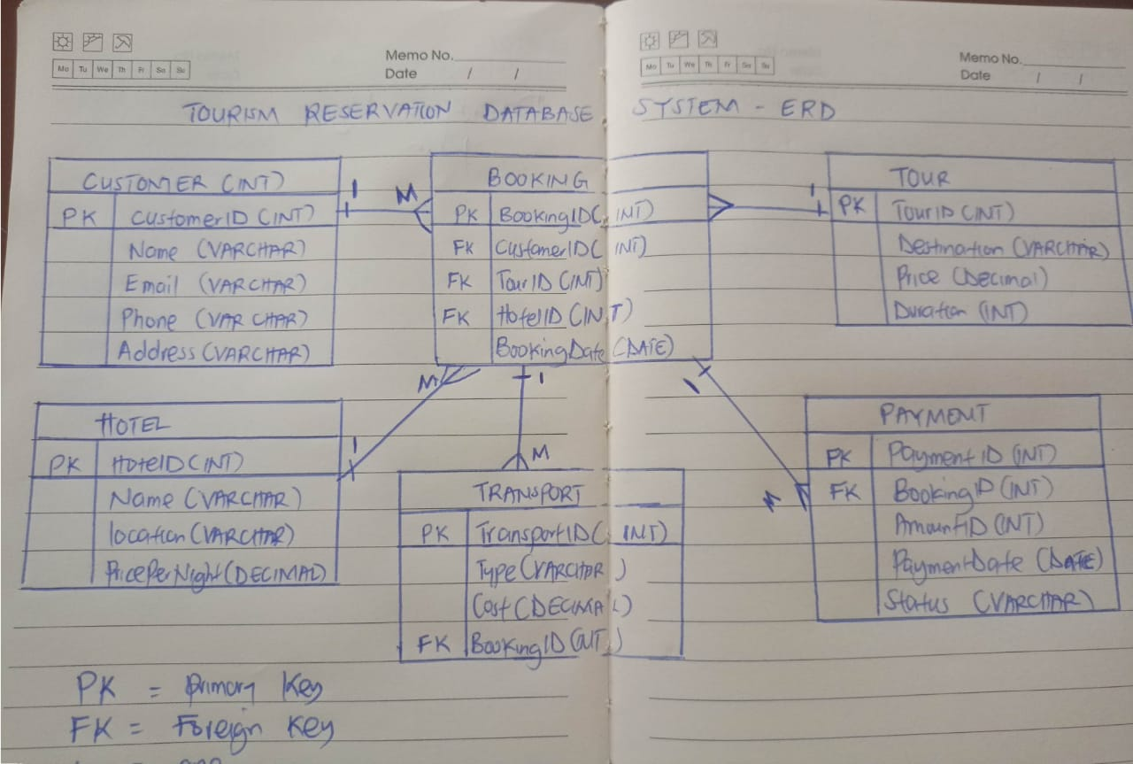
ERD DIAGRAM
Notes:
This slide shows the Entity Relationship Diagram of the system. It provides a visual representation of how all the entities are connected. The Booking table is the central entity linking Customer, Tour, and Hotel. It also connects to Payment and Transport tables, ensuring that all related data is properly organized.

Slide 10
Normalization
Reduced redundancy
Organized data
Improved efficiency
Notes:
The database was designed using normalization principles. This helps reduce data redundancy and ensures that information is stored efficiently. For example, customer data is stored in one table and linked to bookings instead of being repeated multiple times.

Slide 11
Database Schema
6 tables
Primary keys
Foreign keys
Relationships
Notes:
The database schema consists of six main tables: Customer, Tour, Hotel, Booking, Payment, and Transport. Each table has a primary key to uniquely identify records and foreign keys to establish relationships between tables. This structure ensures data integrity and proper linking of all information.

Slide 12
SYSTEM IMPLEMENTATION
Implemented using MySQL in XAMPP
Tables created based on design
Foreign keys used for relationships
Sample data inserted into all tables
System tested using SQL queries
Notes:
The system was implemented using MySQL in the XAMPP environment. Tables were created based on the database design, and relationships were enforced using foreign keys. Sample data was inserted into all tables to test the functionality of the system.

Slide 13
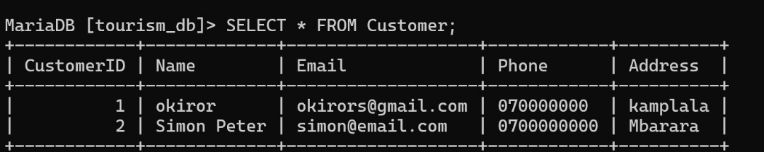
Customer Table Output
Notes:
This slide shows the Customer table in the system. It contains important customer information such as name, email, phone number, and address. For example, we can see a customer stored with their contact details, which can be used during booking and communication. This table ensures that all customer data is stored in an organized and accessible manner.

Slide 14
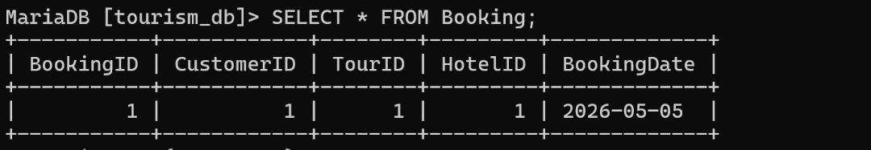
Booking Table Output
Notes:
This slide shows the Booking table, which is the central table in the system. It links customers to tours and hotels through foreign keys. For example, it shows which customer made a booking, the selected tour, the chosen hotel, and the booking date. This table plays a key role in connecting all parts of the system.

Slide 15
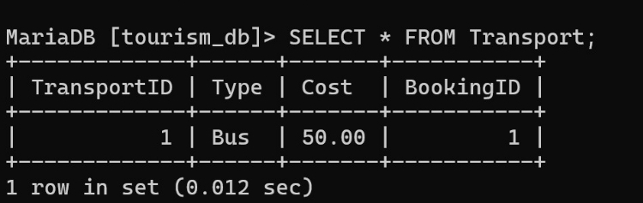
Transport Table Output
Notes:
This slide shows the Transport table. It stores transport details associated with each booking. For example, it shows the type of transport used, such as a bus, and the cost linked to a specific booking. This ensures that transport information is properly linked and managed within the system.

Slide 16
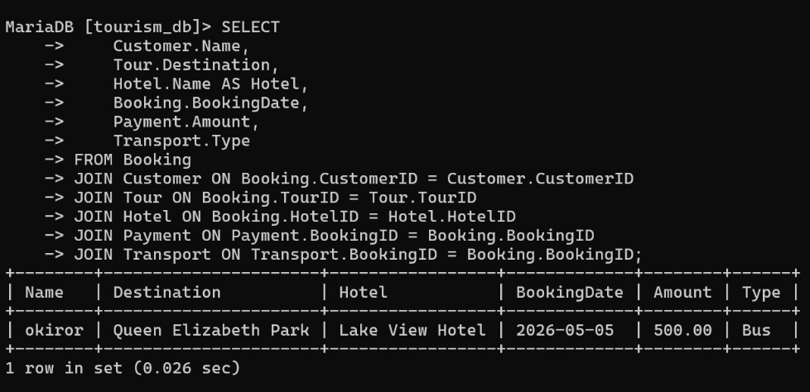
Join Query Output
Notes:
This slide shows the result of a JOIN query. This query combines data from multiple tables into one result. For example, it displays the customer name, tour destination, hotel selected, booking date, payment amount, and transport type all together. This demonstrates that the relationships between all tables are working correctly and the system is functioning as expected.

Slide 17
Challenges faced
Table creation errors
Foreign key issues
System setup
Notes:
During the development of the system, several challenges were encountered. These included errors during table creation and issues with foreign key constraints. For example, one table initially failed to work properly and had to be recreated. These challenges were resolved through testing and debugging.

Slide 18
Future Improvements
Web/mobile interface
Online access
Security improvements
Notes:
In the future, this system can be improved in several ways. For example, a user-friendly web or mobile interface can be developed to allow online access. Additionally, security features can be enhanced to protect user data. These improvements would make the system more scalable and suitable for larger organizations.

Slide 19
CONCLUTION
The system successfully manages tourism bookings
Improves efficiency and reduces manual work
Demonstrates key database concepts
Normalization
Relationships
SQL implementation
Future improvement: web-based interface
Notes:
In conclusion, the Tourism Reservation Database System provides an efficient way to manage tourism operations. It reduces manual work, improves data organization, and ensures consistency through the use of relationships. For example, all booking-related information can be retrieved using a single query.
Thank you for your attention.

